Slide 1
MEASURES OF LOCATION
These are measures of the center of a distribution. They are single values that give a description of the data. They are also referred to as measure of central tendency. Some of them are arithmetic mean, geometric mean, harmonic mean, mode, and median.

Slide 2
In other words, it is an index used to describe the concentration of values near the middle of the distribution. Measures of central tendency are very useful parameters because they describe properties of populations. The word „average‟, which is commonly used, refers to the „centre‟ of a data set. It is a single value intended to represent the distribution as a whole..

Slide 3
The mean is the most commonly used and also of the greatest importance out of the three averages. There are various types of means. We shall however consider the arithmetic mean, the geometric mean and the harmonic mean.

Slide 4
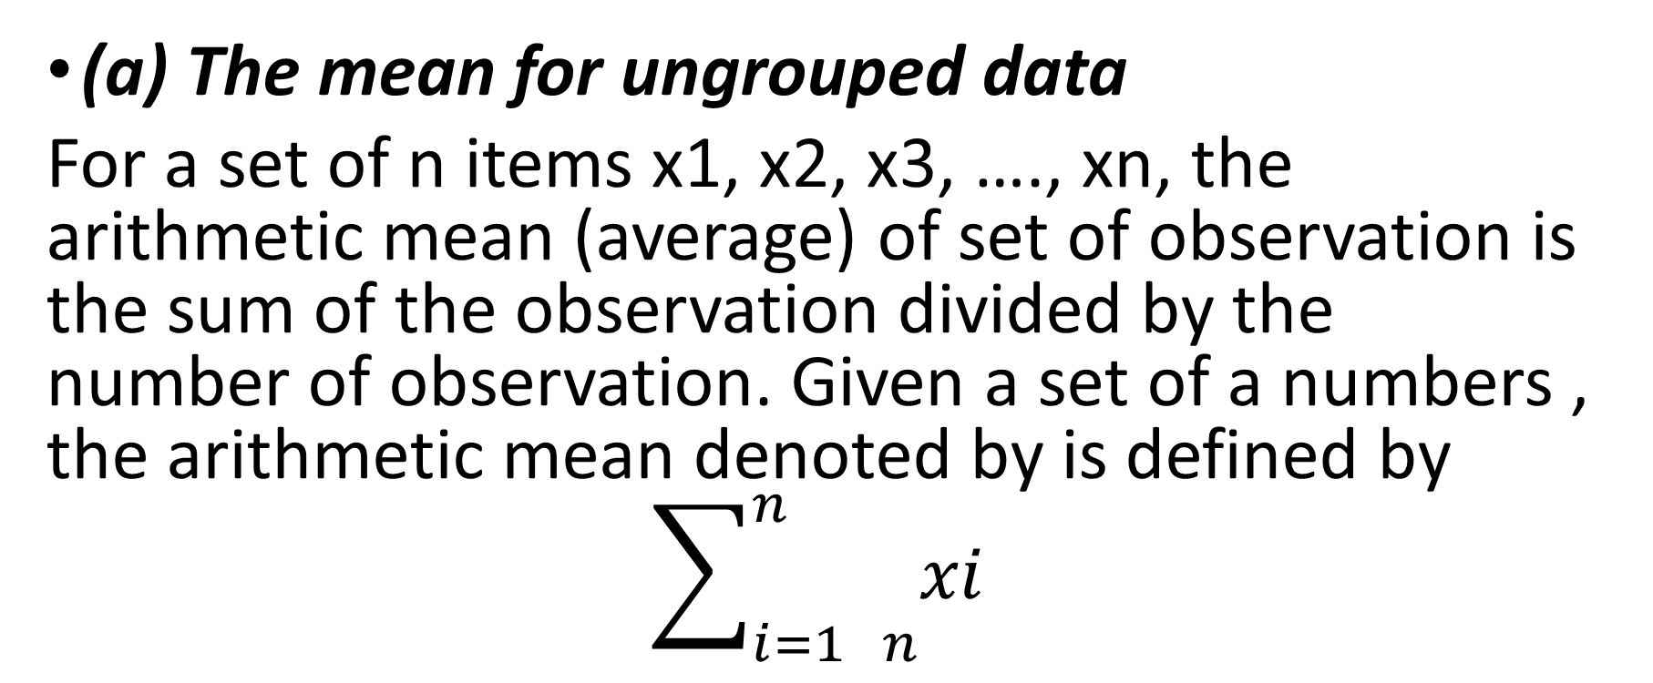
THE ARITHMETIC MEAN (A.M)
(a) The mean for ungrouped data
For a set of n items x1, x2, x3, …., xn, the arithmetic mean (average) of set of observation is the sum of the observation divided by the number of observation. Given a set of a numbers , the arithmetic mean denoted by is defined by
$$\sum_{i=1 n}^{n}{xi}$$

Slide 5
Examples
Example 1: The ages of ten students in STA 111 16,20,19,21,18,20,17,22,20,17, are determine the mean age
.Find the mean using the table below.
SCORE (X) | 2 | 5 | 6 | 8
FREQUENCY | 1 | 3 | 4 | 2

Slide 6
CODING METHOD
The coding method sometimes called the assumed mean method is a simplified version of calculating the arithmetic mean. The computational procedure is as follows.
Assume a value within the data set as the mean, that is the assumed mean
Obtain the deviation of each observation within the data set from the mean. . Calculate the mean of the deviations from the assumed mean. . Calculate the original mean

Slide 7
Calculation of mean from grouped data
If the items of a frequency distribution are classified in intervals, we make the assumption that every item in an interval has the mid-values of the interval and we use this midpoint for .
The table below shows the distribution of the waiting items for some customers in a certain petrol station. Find the average waiting time of the customers.

Slide 8
Waiting time(in mins) | 1.5 – 1.9 | 2.0 – 2.4 | 2.5 – 2.9 | 3.0 – 3.4 | 3.5 – 3.9 | 4.0 – 4.4
No. of customers | 3 | 10 | 18 | 10 | 7 | 2

Slide 9
The exact pension allowance paid (in Nigeria) to 25 workers of a company is given in the table below.
Pension in N | 25 | 30 | 35 | 40 | 45
No of person | 7 | 5 | 6 | 4 | 3
Calculate the mean using an assumed mean 35

Slide 10
The table below shows the monthly wage of twenty employees, compute the mean using both methods.
Monthly wage (N‟000) | No of employees
5 | 4
10 | 7
15 | 3
20 | 5
25 | 1
- | 20

Slide 11
The distribution below shows the life – hours of some high powered electric bulbs measured in hundreds of hours, Calculate the mean of the distribution below using the assumed mean method.
Class Interval | No of tubes (f)
1 – 5 | 5
6 – 10 | 15
11 – 15 | 18
16 – 20 | 20
21 – 25 | 25
26 – 30 | 9
31 – 35 | 5
36 – 40 | 3

Slide 12
THE MEDIAN
This is the value of the variable that divides a distribution into two equal parts when the values are arranged in order of magnitude.
The median of ungrouped data: - The median of a set of data in an array is the value that divides the data set into two equal halves. That is, when these observations are arranged in order of magnitude, half of them will be less than or equal to the median, while the other half will be greater than or equal to it.

Slide 13
The Median of grouped data:- The median of grouped data can be obtained either by the use of formula or graphically. The formula is given by

